Slide 1
Access and Approval
Process
Business Customer Gateway (BCG)
USPS Mail Analytics

Slide 2
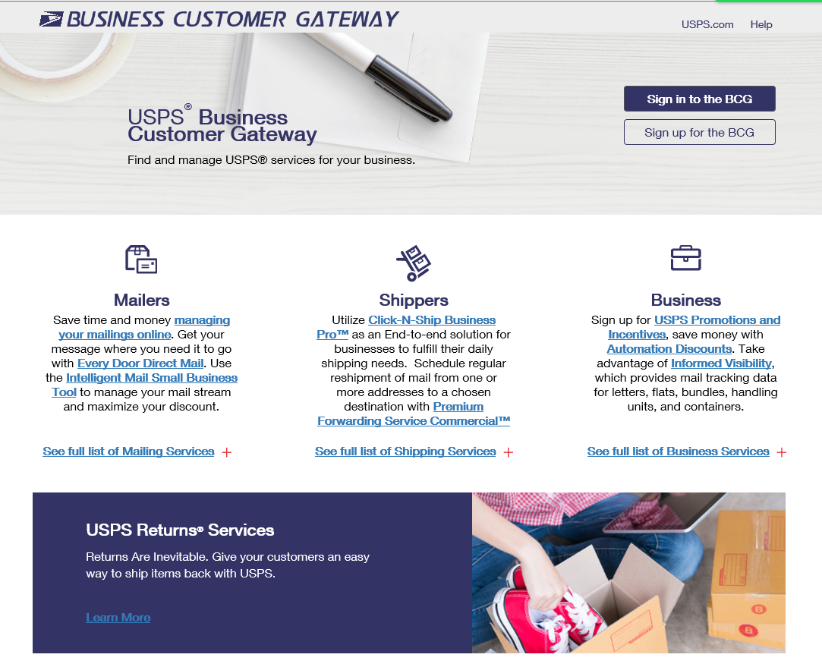
Gaining Access

Slide 3
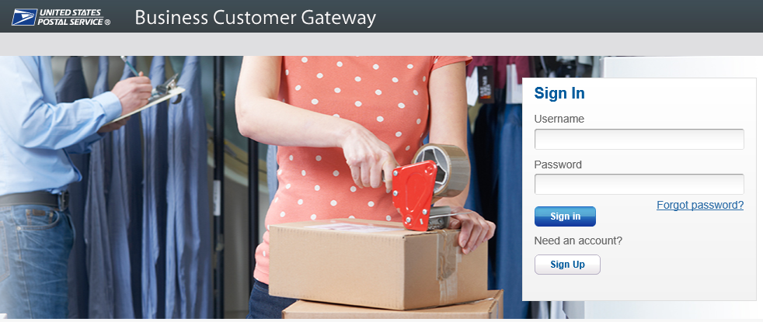
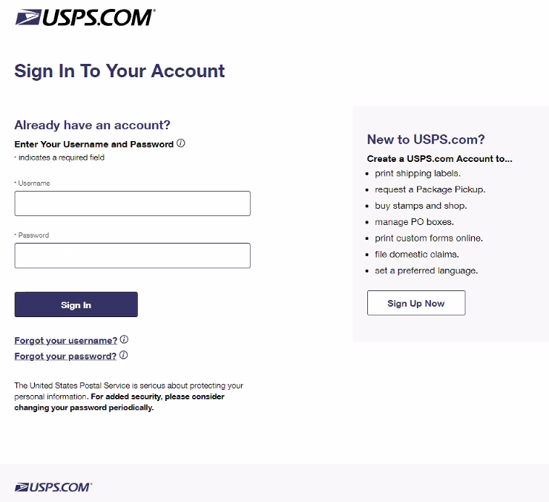
Two ways to enter the Application
Gateway.usps.com
USPSMailAnalytics.com

Slide 4
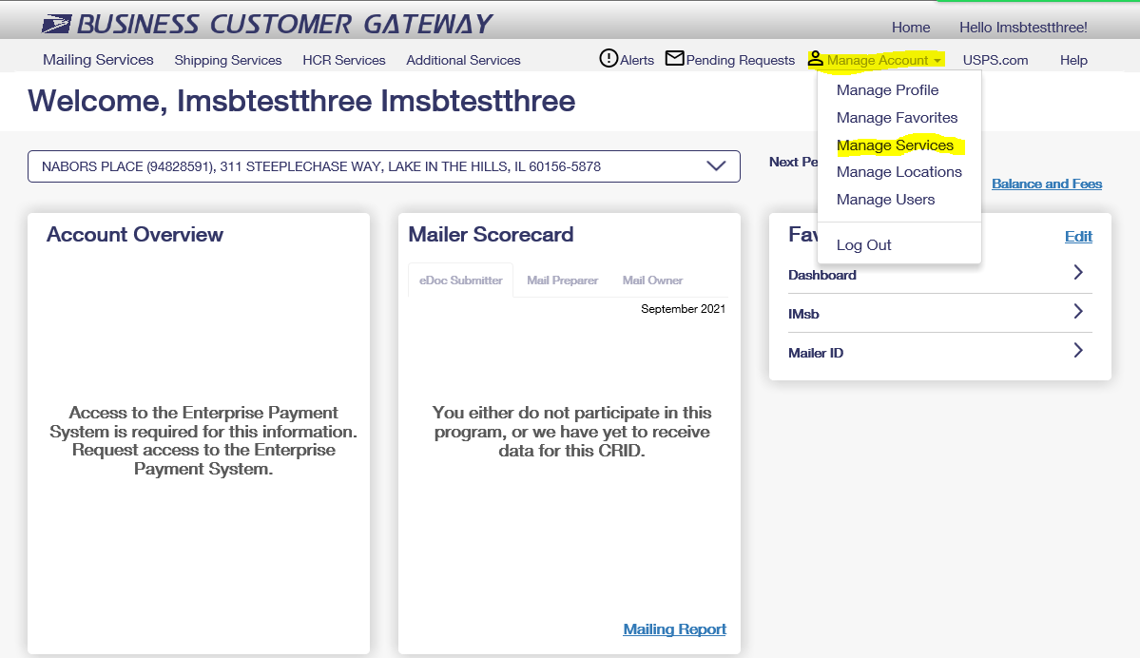
Main Page After Logging In
Mailers will select Manager Accounts tab
Then select Manage Services

Slide 5
What Customers Will Do to Gain Access
After selecting Manage Services, the below screen will give you the options to select all the services we have to offer. Customer will find USPS Mail Analytics and select Get Access.

Slide 6
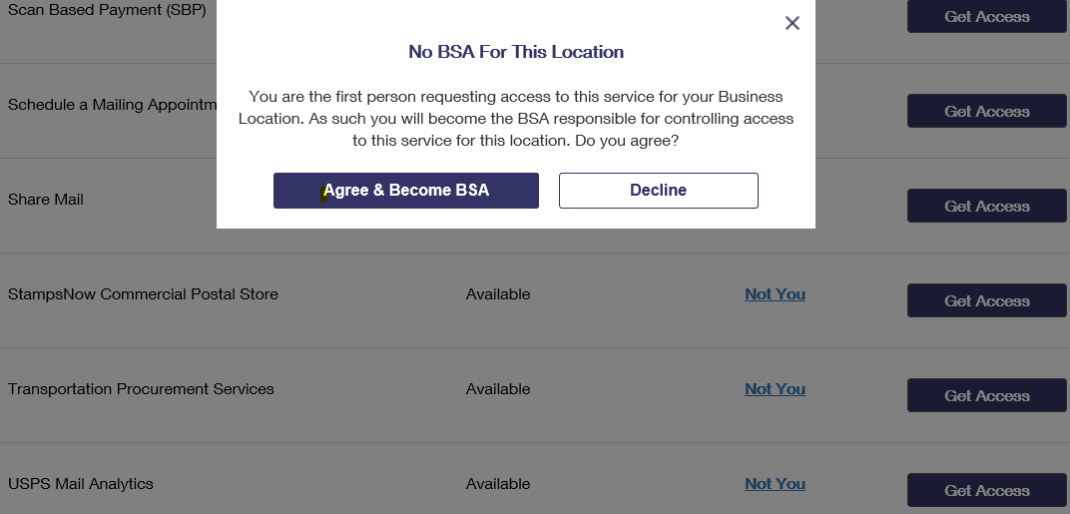
First Person Requesting Access
The first-person requesting access to the USPS Mail Analytics Service will see the message to the left.
Once you select Agree & Become the * BSA your status will move to Pending Help Desk as shown.
This will generate an email to the MSSCADMIN Helpdesk for validation and approval.
* Business Service Administrator - BSA

Slide 7
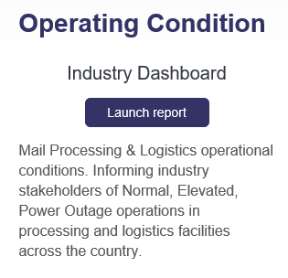
.

Slide 8
BSA Approval for Industry SPM Exclusion tool
2. Select “Manage Account” then “Manage Services”
1. Log into BCG Account
3. Select “USPS Mail Analytics” link
5. Request becomes “Pending Help Desk” status
4. Select “Get Access”
6. Once put into pending status this triggers email to MSSCADMIN@usps.gov
7. MSSC review pending access request to verify requester is associated with the company and are authorized access to the requested CRID
9. BSA grant access for any subsequent requests from that company
8. MSSC grants access to requester as BSA

